Slide 1
Group Size and Social Ties in Microfinance Institutions
Klaus Abbink, Bernd Irlenbusch, Elke Renner

Slide 2
Why microcredit?
Too poor to offer collateral
High risk
Live in remote rural villages
Beyond reach of the traditional banking system
Complex and myriad nature
Monitoring cost high

Slide 3
Basic Idea
Traditional loan lending has some problems
So introduce group lending
With joint liability and possibility being cut from continuous lending
Curtain problems in group lending (1-4)
Incentive to free ride: if individual borrowers rely on their fellow to repay the loan, it gives former and incentive to free ride
In order to solve the free-riding problem,we have three methods:
Group size
Social ties
Dynamic incentives

Slide 4
Basic Idea
Free-riding incentives depends crucially on group size
Larger size, individual tends to shirk (strategically default)
Larger size, group repayment rate tends to be higher
Social ties
Close social ties enhance peer pressure and group solidarity
Better information, prevent from misreporting succession of project, good for verification of success
However, close relationship lead to more forgivingness toward defaulter
Dynamic incentives
In the urban contexts of transition economies, more difficult to form self-selected groups
Follow-up loans are subject to whether previous loans have been repaid
Appropriate?
Self-selected?
Useful?

Slide 5
Laboratory experiment
Why not empirical experiment?
Controlled empirical experiment in which single properties of institutions are systematically varied
Data accessibility and comparability so hard
Relevant variables hard to observe, like individual project risk
Introduce an alternative approach
Could control for specific parameters and observe behavior in simulated MFI scenarios directly in an interactive laboratory experiment

Slide 6
Related Experimental Studies
No laboratory experiments on microcredit institutions
public good
Similarity between public good and Microlending
Theoretically no individual would like to contribute in a single game

Slide 7
Public good games
A group of 2 person, each has $6 initially. If they both contribute $6, suppose return rate is 2/3, they get $4 return. Total return is $8. public goods, they share, each utility is 8.
If one contributes the other not, contributor gets $4 share with non-contributor who both keep his own $6 but also get $4 from contributor, total is $10.
Not investment (contribution) is a dominant strategy
A | B | Invest | Not invest
Invest | (8,8) | (4,10)
Not invest | (10,4) | (6,6)
P.E.
N.E.

Slide 8
Experiment introduction
Model a situation that repayment is not compatible with own-income Max
Follow-up loans are subject to full repayment in the past
Each member of a group invests in an risky project
Whether succeeds or not is known only to individual investor
Subjects (each individual) decide whether to contribute to group repayment or not
Only those with successful projects are able to contribute
Ends if too few contribute, fail to repay initial debt

Slide 9
What we focus
Group size
Set group size to n=2, 4, 8
Dynamic incentive structure
Effect of potential loans on repayment of previous debt
The intensity of social ties
Effect of self-selected group v.s randomly formed group

Slide 10
Experiment introduction
Conducted in the Erfurter Laboratorium fur experimentelle Wirtschaftsforschung at the University of Erfurt, Germany
248 subjects
Most of them are students (economics,law, sociology constituted the largest fractions)
Register either in individual or in group (4)
IR:individual recruitment
GR: Being required to indicate the intensity of their contact each other from a scale of 1 (no contact) to 7
Present the microfinance situation to subjects but not the story

Slide 11
Model Assumptions
Individual repayment cannot be enforced (can default even if the project success)
Individuals have no means of verifying the success or failure of their fellow borrower’s projects
Success of the individual projects is uncorrelated
Symmetric situation (no difference is individuals strategic situation);max own income
No income from other source

Slide 12
Model
A group of n individuals receives a loan; repayment jointly liable
Get a loan of 175 taler (fictitious currency in exp)
Enables each group member to invest in a risky project (same return and probability of success )
Success in 5/6, 83.3%
Project payoff 420 taler if success
For repayment,
each one is supposed to repay 210 taler (assume a loan of 175 talers with in interest rate of 20%)
Total amount by group is 210n taler (MFI not care which individual pay it but care whether this group can pay it or not)
Group failed to repay is banned from borrowing in next round
The debt of 210n talers is split evenly among those individuals who are able and willing to contribute
(full repayment is only possible if at least half of the group members contribute)
After each round, be informed about # of contributors, round payoff

Slide 13
Procedures
Introductory talk
Subjects were seated in rooms visually separated from one another by curtains (IR) together (GR)
Each subject rolled a die to determine success of project, losing number was announced randomly
If success, get a payoff from experimenter, if fail, no payoff (no loan given, just final payoff)
Subjects decide whether to contribute their return by ticking yes or no boxes on one page, hand in
Experimenters compute the results of the rounds
Repeat 10 rounds total,no loan after 10 rounds

Slide 14
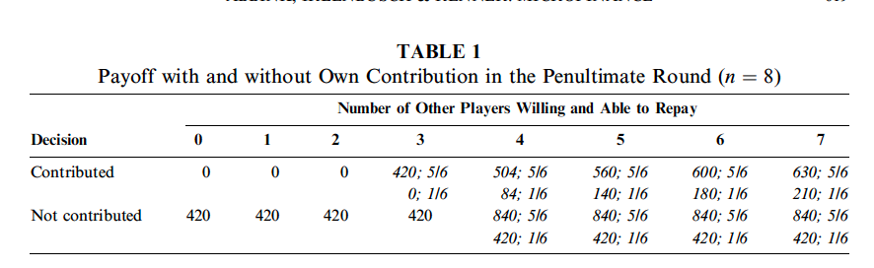
theoretically
No contributions at all
Backward induction looking at penultimate (9th) round
Play will end after the first round

Slide 15
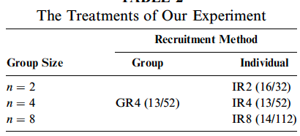
treatment

Slide 16
Method for statistic
Nonparametric tests
Fisher’s two-sample permutation test
Whether two independent samples are likely to be drawn from the same distribution
Rejection of the null hypothesis:one sample is different with the other one
E.g. coefficient is not 0 at α=5%. Repayment rates of IR2 and IR4 is statistically significantly different ( control other factors)

Slide 17
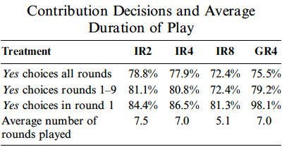
Results
Contribution decisions (description not statistically)
weak support of statistical analysis
Of all pairwise comparisons, we can reject the null hypothesis of equal contribution rates only for the comparison of the contribution rates in rounds 1–9 for IR8 versus IR4. The rates tend to be weakly significantly (p = 0.0219, one-sided, Fisher’s two-sample permutation test) lower in the IR8 condition.
All other differences are not statistically significant (p =0.296 for IR2 versus IR4 and p= 0.166 for IR2 versus IR8, one sided, Fisher’s two-sample permutation test).

Slide 18
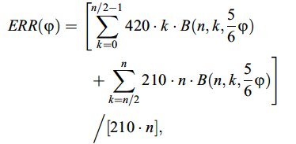
Results
Expected Full Repayment Rates
MFI cares more about repayment rates (total amount of repayment,enough or not?)
One could look at the actual repayment rates realized in the sessions. However, these are highly influenced by the realizations of the random draws

Slide 19
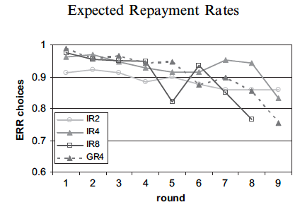
Results
Outperform individual lending (ERR > 5/6)
Decrease ERR but weak support of statistical analysis
The nonparametric Jonckheere test, rejects the null hypothesis of equal rates in favor of the hypothesis of decreasing rates at a weak significance level of p = 0.08 (one-sided).

Slide 20
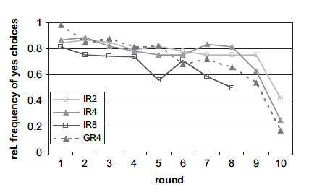
Dynamics of play
Contribution Decisions over Rounds
Expect contribution rates to decrease toward the end of play
More than two-thirds of subjects contribute in round 7

Slide 21
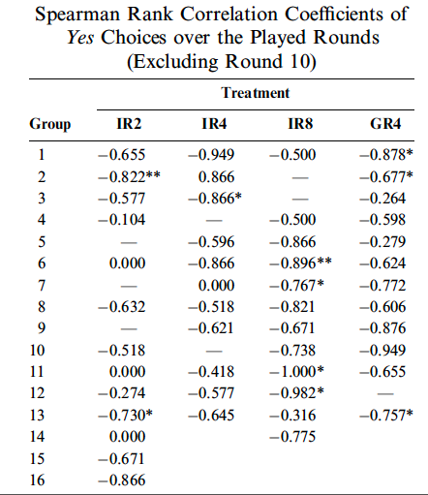
Dynamics of play
Contribution decisions can be observed also in single groups
Compute correlation coefficients between the number of yes choices and the number of rounds.
Rejects the null hypothesis at α=0.05
With increase of # of round, people are less willing to contribute

Slide 22
conclusion
Group lending outperforms individual lending
Repayment rates higher than those by individual
Small group size decrease incentive to free-ride but ERR are no significant different
self-selected groups show high but less stable contributions
Relatively moderate effect on repayment rates
Dynamically people are less willing to repay loan if lending is likely to stop

Slide 23
Shortcomings
No borrow (less incentive to protect their loan)
Self-selected group may not best fro repayment of loan
Monitor pressure of group not appears (influence social ties)
Experiment time only 1.5 hours comparing to actual world…

